Slide 1

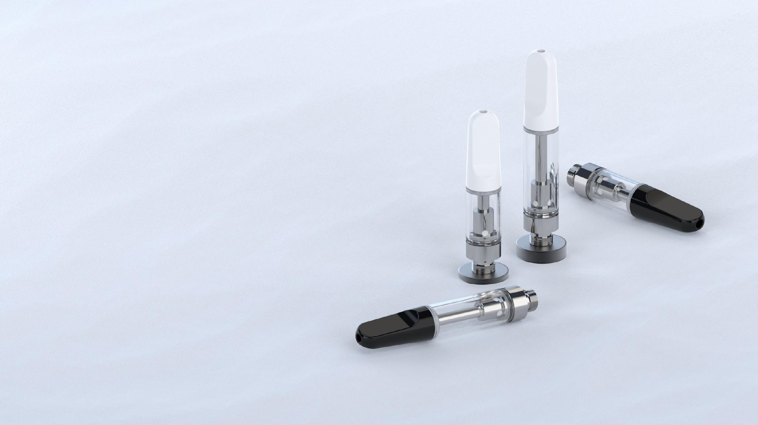
TH2-SE
Borosilicate Glass Cartridge

Slide 2

Unrivaled Ceramic Heating Technology
Built with CCELL’s proprietary ceramic heating technology, the TH2-SE enables best-in-class taste and unrivaled quality. Its innovative design and state-of-the-art engineering deliver superior quality and an unmatched level of satisfaction to all consumers.

Slide 3
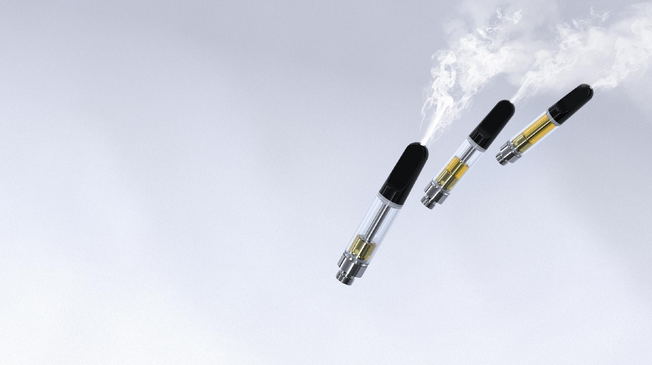
Maximum Consistency.
Across All Product Lines
Our advanced engineering tech and stringent quality control maximize consistency across every product we create and every cloud consumers inhale, as attested to by the 530 million+ CCELL cartridges shipped and used to date.

Slide 4
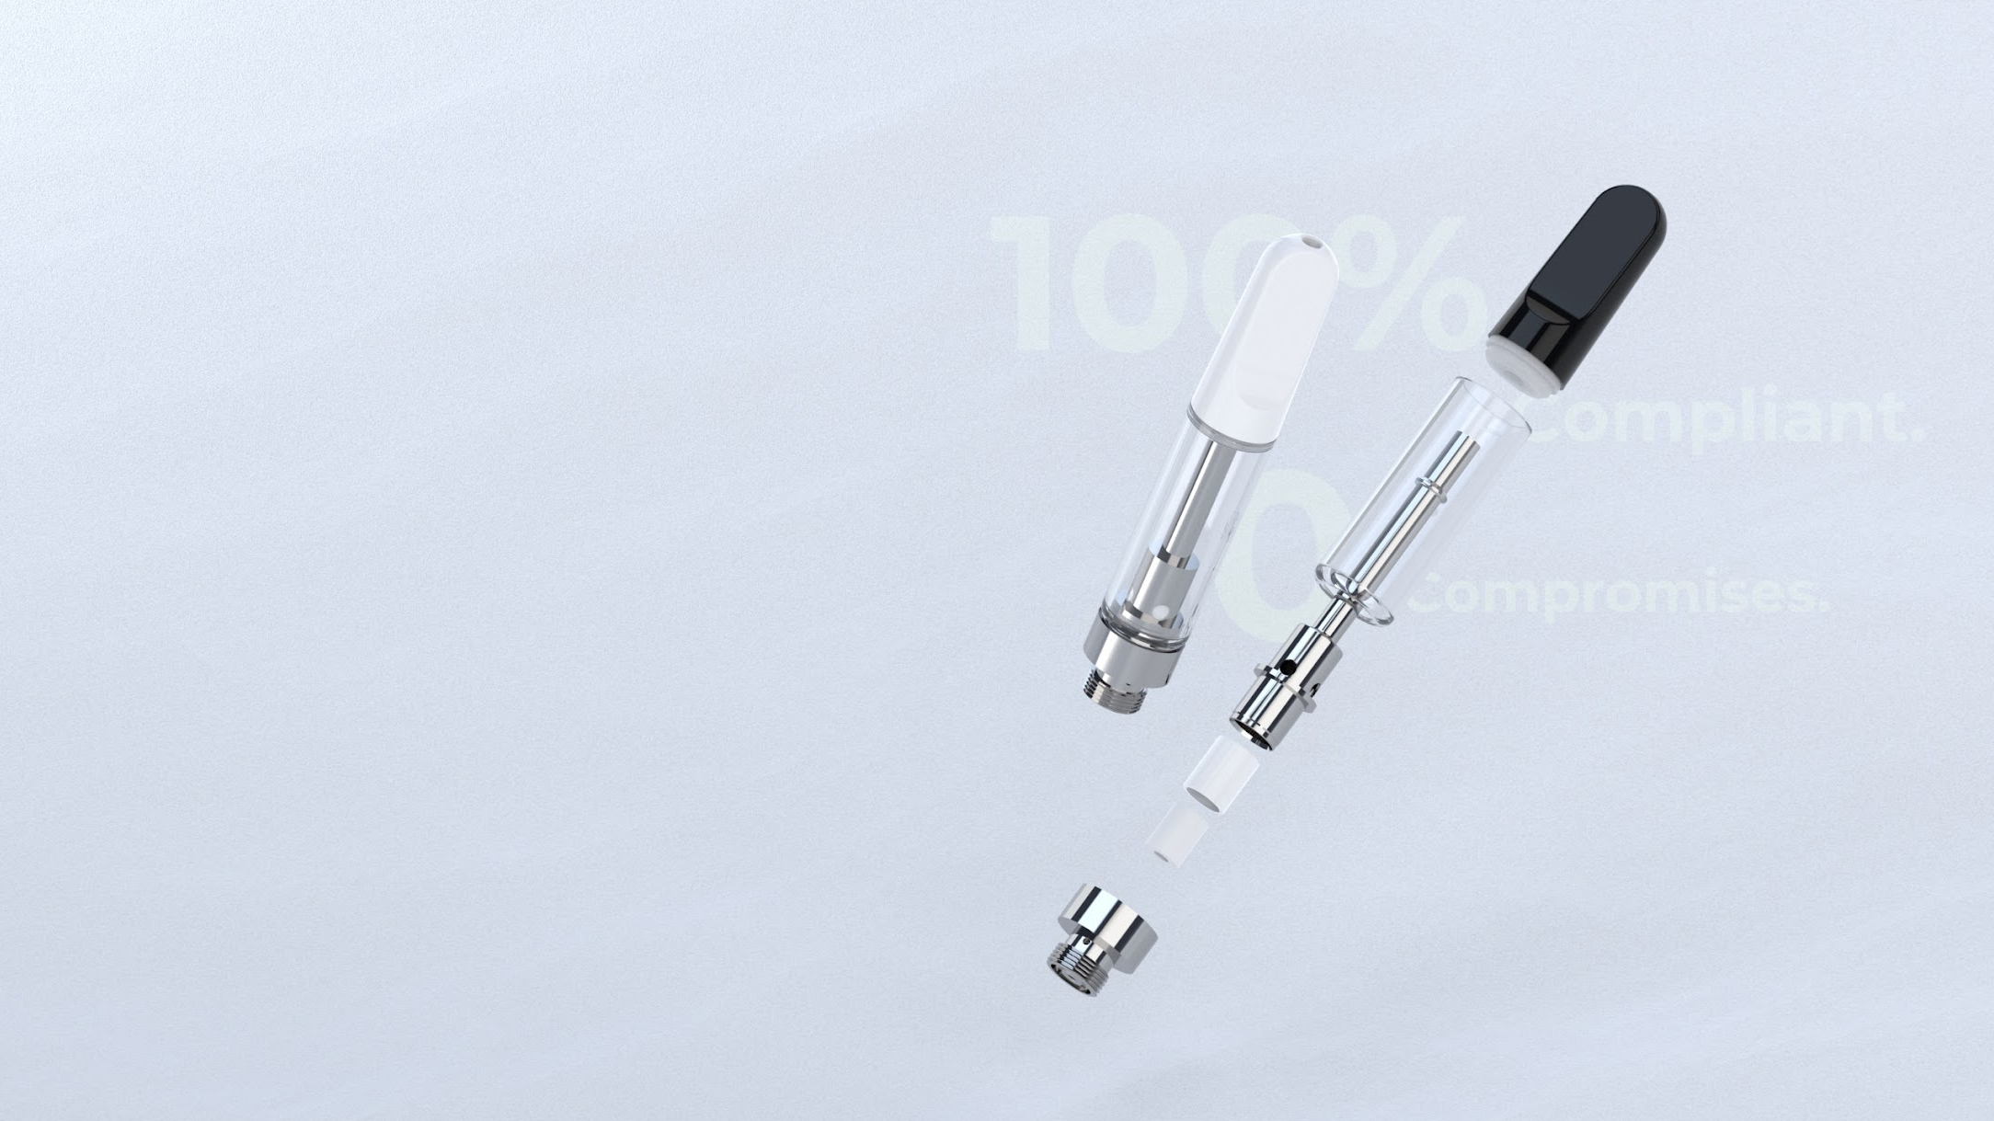
100% Compliant. 0 Compromises.
With meticulous attention to detail, the TH2-SE was crafted to be 100% compliant with industry regulations, ensuring a safe and worry-free vaping experience for all to enjoy. This allows consumers to experience true peace of mind while indulging in exceptional flavor and quality!

Slide 5
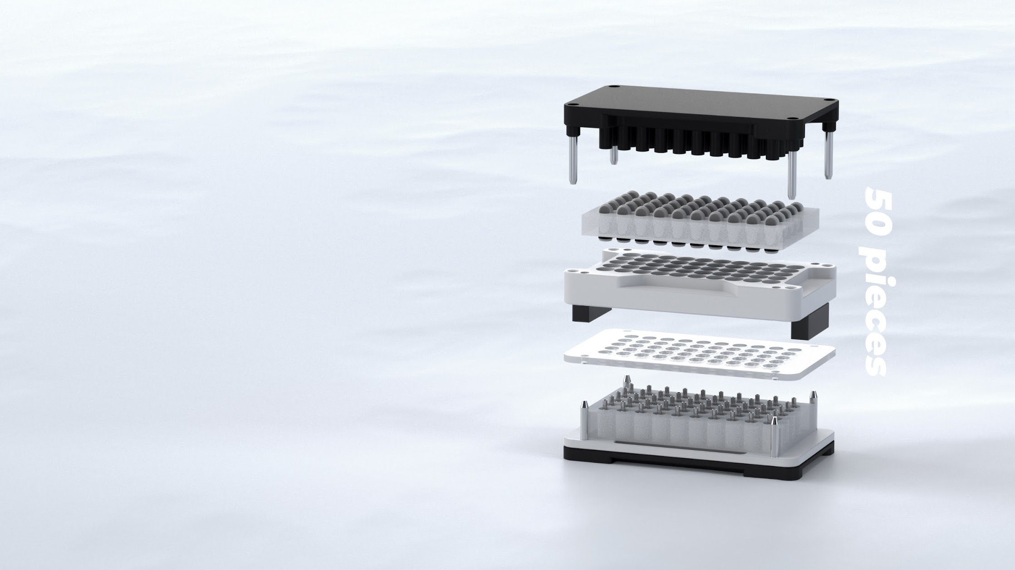
Hassle-Free
Batch-Capping
Streamline your production process with a quick, hassle-free snap, and save valuable time and resources with our snap-fit mouthpiece design. Batch-capped* at 50 pieces at a time, this cartridge provides a tight, secure seal in a flash.
*Batch-capping only available for snap-fit mouthpieces.

Slide 6
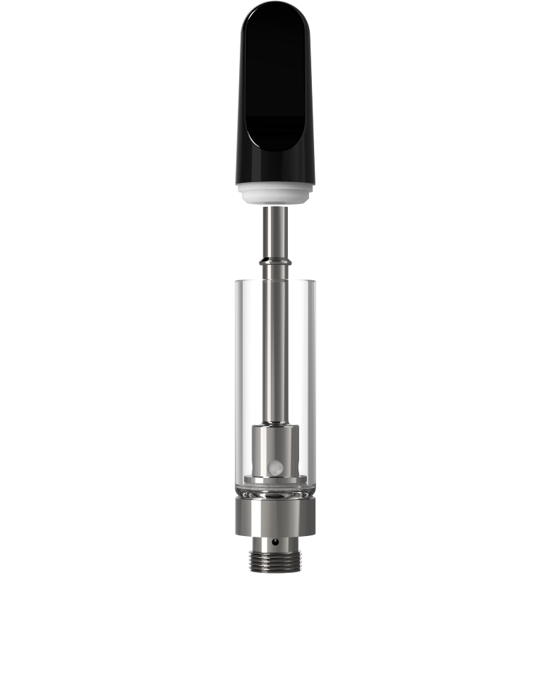
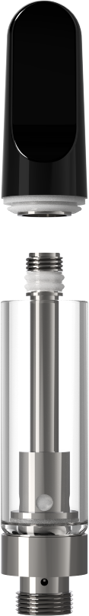
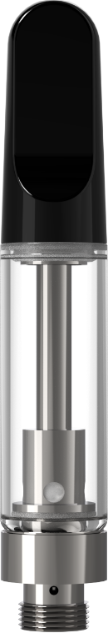
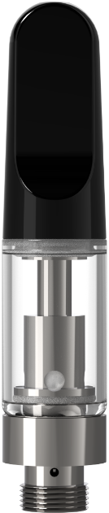
Specs
Snap-fit
Screw-on
0.5ml
1ml
Tank Volume: 0.5ml/1ml
Dimensions: Φ10.5 x 51.8/62.1 (mm)
Φ0.41 x 2.04/2.44 (in)
Resistance: 1.4Ω
Aperture size: 4 x φ2mm
CCELL ceramic heating element
Snap-fit/screw-on mouthpiece
Low-lead brass center post
Borosilicate glass body
Available for customization
51.8mm (2.04in)
62.1mm (2.44in)
Φ10.5mm(0.41in)
Φ10.5mm(0.41in)

Slide 7
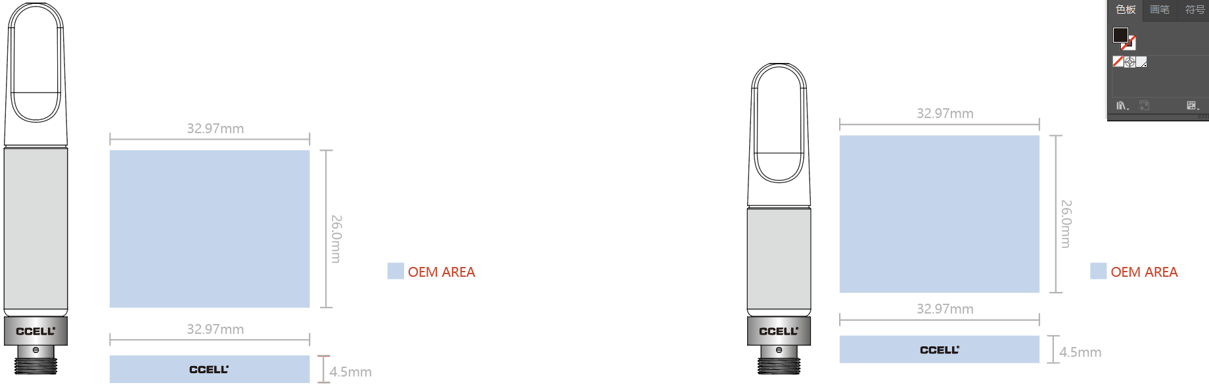

OEM Capabilities
1ml
0.5ml
Oil Tank
32.97mm (1.3in)
OEM Options: Pad printing, silkscreen
Dimensions: 32.97 x 16.5/26 (mm)/1.3 x 0.65/1.02 (in)
32.97mm (1.3in)
26mm (1.02in)
16.5mm (0.65in)
Cartridge Base
4.5mm (0.18in)
4.5mm (0.18in)
OEM Options: Spray painting, electroplating, silkscreen
Dimensions: 32.97 x 4.5 (mm)/1.3 x 0.18 (in)
32.97mm (1.3in)
32.97mm (1.3in)

Slide 8




TH2-SE
Borosilicate Glass Cartridge
FOLLOW US @CCELLOFFICIAL
WWW.CCELL.COM
CCELL DOES NOT PRODUCE, DISTRIBUTE OR SELL ANY MATERIAL FILLED IN CARTRIDGES AND OIL TANKS. NOT FOR SALE TO MINORS.

